Slide 1
INTRODUCTION TO PATHOLOGY Dr.Kaduyu Dennis
SUBTOPIC 1CONCEPTS TO PATHOLOGY
SUBTOPIC 2CAUSES,CLASSIFICATION AND PATHOGENICITY OF DISEASES
SUBTOPIC 3 PHYSIOLOGIC STRESS AND PATHOLOGICAL INJURY AND CELLULAR ADAPTATION
SUBTOPIC 4CELL INJURY AND CELL DEATH

Slide 2
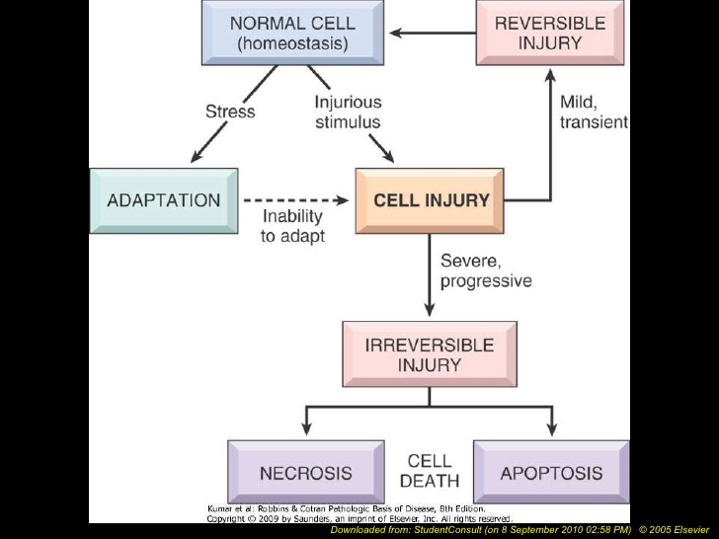
Cellular response to injury
LECT
Dr. Olwa Francis

Slide 3
DEFINITION OF CELL INJURY
Cell injury is a sequence of structural and functional changes the cell undergoes when exposed to an injurious agent or stress.

Slide 4
LEARNING OBJECTIVES
DEFINITION OF CELLULAR INJURY
CAUSES OF CELLULAR INJURIES
TYPES OF CELLULAR INJURIES
REVERSIBLE CELL INJURIES
MORPHOLOGY OF REVERSIBLE CELL INJURIES
IRREVERSIBLE CELL INJURIES
MORPHOLOGY OF IRREVERSIBLE CELL INJURIES
APOPTOSIS
IMPORTANCE/BENEFITS OF APOPTOSIS
NECROSIS
IMPORTANCE OF NECROSIS
COMPLICATIONS OF NECROSIS
DIFFERENCES BETWEEN APAPTOSIS AND NECROSIS

Slide 5
CAUSES OF CELL INJURY
Cells may be injuired by 2 major ways ;
Genetic causes
Acquired causes
Oxygen deprivation: Hypoxia is deficiency of oxygen; causes reduced aerobic cell metabolism and the cell resorts to anaerobic metabolism.
Common causes of hypoxia: anemia, carbon monoxide poisoning
Physical agents e.g. mechanical trauma, extremes of temperature, electric shock, radiation etc

Slide 6
Chemical agents and drugs
eg chemical poison such as cyanide ,mercury ,asbestos, alcohol abuse
Infectious agents
i.e bacteria viruses ,protozoa etc.
Immunological reactions
it protects the host against various injurious agents but it may also turn lethal and cause cell injury e.g. hypersensitivity reactions; anaphylactic reactions; and autoimmune diseases.
Genetic derangements .e.g. haemglobin S in sickling disease, in born error of metabloism.
Nutritional imbalance. This can be excess or under nourishment. Excessive lipid cause atherosclerosis.

Slide 7
PATHOGENESIS OF CELL INJURY
Depletion and decrease in ATP production occurs in hypoxic and chemical injury.
ATP is required for cell metabolism such as membrane transport, protein synthesis lipogenesis etc.
Depletion of ATP will result in:
Reduced plasma membrane energy-dependent sodium pump (Na+, K+-ATPase) this causes sodium to accumulate intracellularly and K+ to diffuse outside. Sodium entry is accompanied by water leading to net cellular swelling
Altered cellular energy metabolism: reduction in oxygen supply, e.g. in ischemia leads to cessation of oxidative phosphorylation and the cell relies on anaerobic respiration for metabolism by glycolysis there will be depletion of glycogen stores.

Slide 8
There will also be accumulation of lactic acid reducing intracellular PH with subsequent reduction of intracellular enzyme activities and clamping of nuclear chromatin( material that makes up a chromosome that consists of DNA.
Failure of Calcium pump leads to influx of calcium ions and damaging numerous cellular components e.g. lysosome damage escape of lysosome enzymes which are activated due to lack of oxygen in the cell and acidic ph hence
causing nucleoprotein damage i.e
pyknosis- condensation and clumping of nucleus.
karyorrhexis –nuclear fragmentation into small bits .
karyolysis-dissolution of nucleus
Increased calcium in cells activates endogenous phospholipids hence degrade membrane phospholipids
Depletion of ATP leads to disruption of protein synthesis manifested by detachment of ribosomesfrom the rough ER

Slide 9
Factors affecting the pathogenesis of most forms of cell injury
The type of the agent
Duration of the exposure
Severity of the agent
State of the cell (metabolic and hormonal status)
Type of the cell
adaptability of the cell

Slide 10
Types/classifications of cellular injuries
Reversible cell injury
Irreversible cell injury

Slide 11
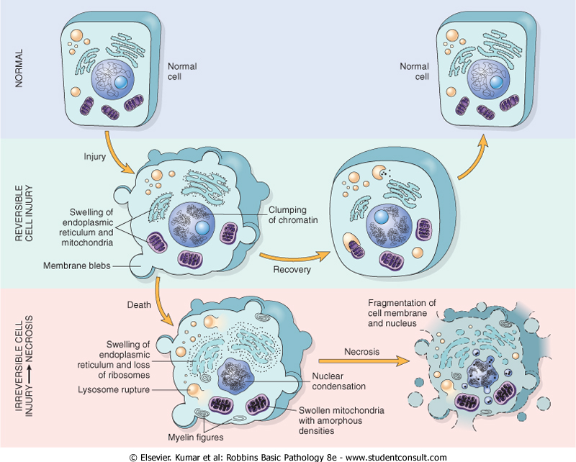

Slide 12
Reversible cell injury
Reversible cell injury is when the damaged cell is capable of returning to its normal physiological state when the stress is removed from the cell.
N.B Low levels of stress can cause reversible cell injury ,exceeding the
threshold results in irreversible injury.
MORPHOLOGY OF REVERSIBLE CELL INJURY
LIGHT MICROSCOPY
Cellular swelling
Fatty change/ steatosis
Vacuolar degeneration/ hydropic change
ULTRASTRUCTURAL CHANGES(high magnification with electron microscope)
Plasma membrane alterations such as blebbing(bulging of the plasma membrane) ,blunting (weakened) and loss of microvilli(microscopic cellular membrane protrusion's that increase surface are for absorption ,secretion ,cellular adhesion)
Mitochondrial changes
Dilatation of endoplasmic retinaculum with detachment of polysomes
Nuclear alterations with disaggregation of granular and fibrillar elements
GROSS APPEARANCE
Organ pallor
Organ rigidity
Increased weight

Slide 13
CELLULAR SWELLING
This is the first manifestation of almost all forms of cell injury.
It occurs when the cell is unable to maintain ionic and fluid homeostasis as a result of loss of plasma membrane energy- dependent
Ion pumps.
FATTY CHANGE/STEATOSIS
This is the abnormal accumulation of triglycerides within parenchymal cells.eg in Alcoholic hepatitis
Fatty change is manifested by the appearance of lipid vacuoles in the cytoplasm
this is mainly seen in cells involved in and dependent on fat metabolism such as hepatocytes and myocardial cells.
GROSSLY; Liver is enlarge, yellow in color and shiny in appearance because it contains excess fat

Slide 14
VACUOLAR DEGENERATION /HYDROPIC CHANGE
This is a pattern of non-lethal cell injury where small clear vacuoles are seen within cytoplasm representing distended and pinched off segments of endoplasmic retinaculum.

Slide 15
IRREVERSIBLE CELL INJURY
Irreversible cell injury is one which occurs when a causative agent persists or if its severe enough from its on set resulting into cell death.
TYPES OF CELL DEATH/ CELLULAR CHANGES WHICH ARE IRREVERSIBLE
Necrosis
Apoptosis
N.B
Historically 2 principles of cell death necrosis and apoptosis which differ in their morphology ,mechanisms and roles in physiology and disease have been recognized.

Slide 16
APOPTOSIS(NECROBIOSIS)
DEFINITION
Apoptosis is a form of coordinated and internally programmed cell death having significance in a variety of physiologic and pathologic conditions
OR
This is cell death induced by tightly regulated intracellular program (programmed cell death)
N.B Apoptosis eliminates cells that are injured beyond repair without eliciting a host reaction .

Slide 17
CAUSES OF APOPTOSIS
PHYSIOLOGIC PROCESSES
Organized cell destruction in sculpting of tissues during development of embryo
Physiologic involution of cells in hormone-dependent tissues e.g endometrial shedding during menstrual cycle ,regression of lactating breast after withdrawal of breast-feeding
Normal cell destruction followed by replacement proliferation e.g intestinal epithelium
Death of cell which have served their usefulness e.g neutrophils dying after acute inflammatory response.

Slide 18
PATHOLOGIC PROCESSES
Cell death in tumors exposed to chemotherapeutic agents i.e. these cause damage to DNA and if the repair mechanism cannot cope up with the injury the cells die using apoptosis.
Progressive depletion of CD4 T helper cells in the pathogenesis of AIDS
Accumulation of misfolded proteins
improperly folded proteins may arise because of mutations in the genes, excess accumulation in endoplasmic retinaculum leads to ER stress leading to apoptic cell death.
Cell death in certain infections particularly viral infections
the body has cytotoxic T lymphocytes specific for viral proteins which induce apoptosis of infected cells in an attempt to eliminate reservoir of infection.

Slide 19
Morphological features of Apoptosis
These changes are best demonstrated using electron microscope, they include:
Cell shrinkage: the cells are smaller in size, with dense cytoplasm and organelles are tightly packed.
Chromatin condensation: the most characteristic feature of apoptosis, chromatin aggregate peripherally under nuclear membrane into dense masses of various shapes and sizes.
Formation of cytoplasmic blebs and apoptotic bodies (cytoplasm with tightly packed organelles with or without nuclear fragments.
Phagocytosis of apoptotic bodies seen in the macrophages.

Slide 20
Significance of apoptosis
• Balancing cell proliferation and elimination.
• Maintenance of organ size.
• Organ development and modeling in the embryo
• Physiological atrophy and involution

Slide 21
NECROSIS
DEFINITION
Necrosis is defined as a localized area of dead tissue followed by degradation of tissue by hydrolytic enzymes liberated from dead cells .
it is invariably(always) followed by inflammation
CAUSES
Can be caused by various agents e.g. hypoxia ,chemical and physical agents, microbial agents ,immunological injury etc.

Slide 22
Necrosis takes place by 2 concurrent biochemical processes
Enzymatic digestion (Cell digestion by lytic enzymes)
These enzymes are derived from lysosomes of dead cells
Protein denaturation (destruction of tertiary structure of protein molecule into polypeptide chains)
This process is morphologically seen as characteristic nuclear changes in necrotic cell. These nuclear changes may include;
condensation of nuclear chromatin (pyknosis) which may either undergo dissolution(karyolysis) of fragmentation into many granular clumps (karyorrhexis)

Slide 23
TYPES OF NECROSIS
MORPHOLOGICALLY THERE 5 TYPES OF NECROSIS
– Coagulative necrosis
– Liquefractive necrosis
– Fat necrosis
– Caseous necrosis
– Fibrinoid necrosis

Slide 24
COAGULATIVE NECROSIS
DEFINITION
Is a form of necrosis in which the cell basic structure of the dead tissues is preserved for a span of some days.
Its called “coagulative “ because the affected tissue exhibit a firm texture
A localized area of coagulative necrosis is called an infarct
N.B It is presumed the causative agent denatures not only the structural proteins but also enzymes and so blocks the proteolysis of the dead cells however ultimately the necrotic cells are removed by phagocytosis.
This is the most common type of necrosis caused by irreversible cell injury mostly from sudden cessation of blood flow resulting into ischemia LESS OFTEN from bacterial and chemical agents
COMMONLY AFFECTED ORGANS
Heart(heart infarts),kidney(renal infarct), spleen

Slide 25
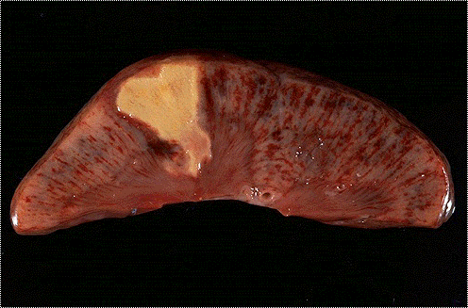
TYPES OF NECROSIS
Coagulatuve necrosis: this is the type of necrosis in which the structural cellular outline is preserved for some time. The affected tissue/organ exhibits a firm texture e.g. myocardial infarction.
Liquefactive necrosis: this where the dead tissues are transformed into viscous liquid mass it is characteristically seen in focal bacterial infection leading to abscess formation. It is also exhibited in central nervous tissue necrosis.
Caseous necrosis this is a distinct form of coagulation necrosis encountered in foci of tuberculous infection. This term is derived form cheesy gross appearance of the lesion.

Slide 26
liquefactive necrosis(colliquative necrosis)
DEFINITION
this is one characterized by digestion of the dead tissue resulting into transformation of the tissue into liquid viscous mass
COMMON CAUSES
Ischemic injury ,bacterial infection or fungal infection
It is called “liquefactive “ because the microbes stimulate the accumulation of leucocytes and liberation of enzymes from these cells
resulting usually into a creamy yellow substance due to presence of dead leucocytes called PUS
COMMONLY SEEN IN
BRAIN,ABSCESS

Slide 27
liquefactive necrosis of the brain

Slide 28
FAT NECROSIS
This is a special form of cell death occurring in focal areas of fat destruction.
It does not have a specific pattern of necrosis
Occurs in 1, acute pancreatitis
2,traumatic fat necrosis common in breast injuries
In cause of pancreatitis there is liberation of pancreatic lipases resulting into necrosis of pancreas itself and fat deposits through out the peritoneal cavity affecting the extra abdominal adipose tissue

Slide 29
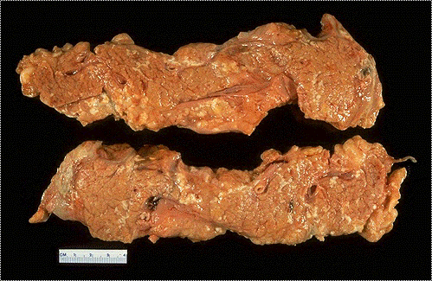

Slide 30
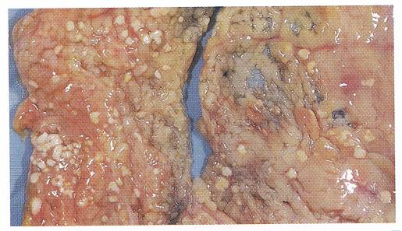

Slide 31
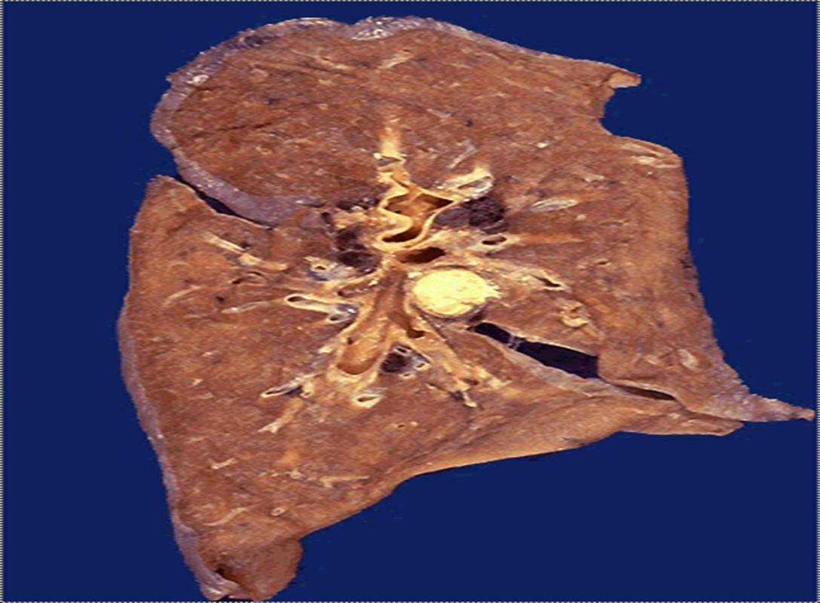
CASEOUS NECROSIS
This is found in the centre of foci of Tuberculosis infections where the tissue maintains a cheese-like appearance “caseous”.

Slide 32
FIBRINOID NECROSIS
This is a special form of necrosis usually seen in immune reactions involving blood vessels e.g. autoimmune diseases .
This pattern of necrosis typically occurs when complexes of antigen and antibodies are deposited in walls of arteries

Slide 33
Morphology of irreversible cell injury (Necrosis):
Light microscopy:
Membrane rupture
Dispersal of organelles
Breakdown of lysosomes
Nuclear changes-
Karyolysis (DNA breakdown)
Pyknosis (nuclear shrinkage)
Karyorrhexis (nuclear fragmentation)
Gross tissue changes:
coagulative (denaturation), liquifactive (enzymatic digestion), caseous and fat necrosis
Question ; why 2hourly bed turning for bed ridden patients

Slide 34
DIFFERENCES BTN APOPTOSIS AND NECROSIS
FEATURE | APOPTOSIS | NECROSIS
Definition | Programmed and coordinated cell death | Cell death along with degradation of tissue by hydrolytic enzymes
Causative agents | Physiologic and pathologic processes | Hypoxia and toxins
Morphology | No inflammatory reaction Death of single cells Cell shrinkage Cytoplasmic blebs on the membrane | Inflammatory reaction always present Death of many adjacent cells Cell swelling initially Membrane disruption
Molecular changes | Lysosomes intact | Lysosomal break down with release of hydrolytic enzymes

Slide 35
Similarities between reversible and irreversible cell injuries
Both occur when stress acts upon cells
Both caused by physical , chemical and biological agents
In both abnormal cellular responses arise

Slide 36
Differences between reversible and irreversible cell injuries
REVERSIBLE CELL INJURY | IRREVERSIBLE CELL INJURY
Results in morphological and cellular changes that could reverse if the stress istaken off the cell | Results into completes cell death
Cell can return to normal state if stress taken off | Cannot return to normal state if stress taken off

Slide 37
Question
complications of necrosis

